Slide 1

无人机航拍场景下的语义三维重建
陈煜1701213988@pku.edu.cn
王尧 wangyao@pku.edu.cn
王旭普 806218468@qq.com

Slide 2
CONTENTS
Semantic Segmentation
Structure from Motion
Results Display
PART ONE
PART TWO
PART THREE

Slide 3
Division & Cooperation
Name
Student ID
Work
陈煜
1701213988
稀疏点云模型生成
王尧
1701214012
语义分割
王旭普
1701214013
前端结果展示

Slide 4
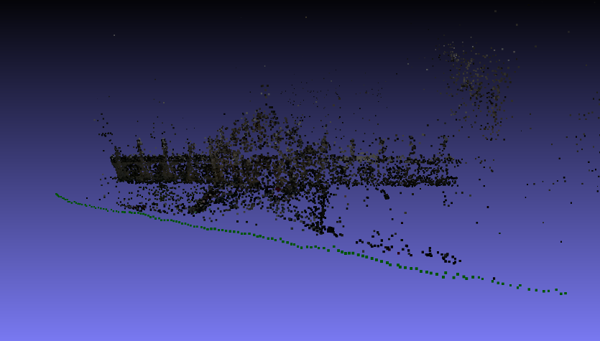
Motivation
3D point noise reduction
Reconstruction speed acceleration
Use semantic informations
Notes:
三维重建中的点云去噪
在目前的科研场景中，公开标注数据最多，最为成熟的室外场景数据集主要包括两种：街景与卫星。
根据我们的调研，没有找到公开的带有像素级标注的无人机航拍数据集 (拍摄⾼度约在40-150米)。

Slide 5
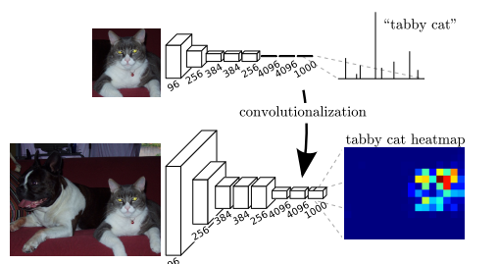
Semantic segmentation
FCN: Transforming fully connected layers into convolution layers
Notes:
将端到端的卷积网络推广到语义分割中；
重新将预训练好的Imagenet网络用于分割问题中；
使用反卷积层进行上采样；
提出了跳跃连接来改善上采样的粗糙程度。

Slide 6

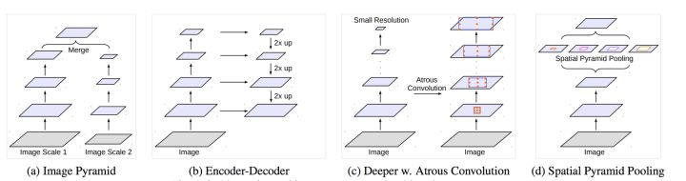
from FCN to Deeplab
Atrous convolution
FCN方案 | 问题 | deeplab解决方案
反卷积 | 特征图分辨率过低，空间位置信息丢失 | 膨胀卷积(Atrous convolution)
跳边结构，多尺度卷积层结果融合 | 小尺度物体无法识别， | 膨胀金字塔池化(Atrous spatial pyramid pooling )
Atrous spacial pyramid pooling
Notes:
需要注意的是，该模型预测分割图的大小是原图像大小的1/8。这是几乎所有方法中都存在的问题，将通过内插方法得到最终分割图。

Slide 7
Dataset Construction
Data selection
Semantic labeling
Post process
Enrich the variety from different:
Drone height
Light(shadow)
Camera angle
Image content
The labeling method is:
By photo shop
Semi-automatic
5 min per image
The main goals are:
To combine semantic masks into single ground truth label
To deal with multi-labeled/unlabeled pixel
Train_set | Validation _set
156 | 45

Slide 8
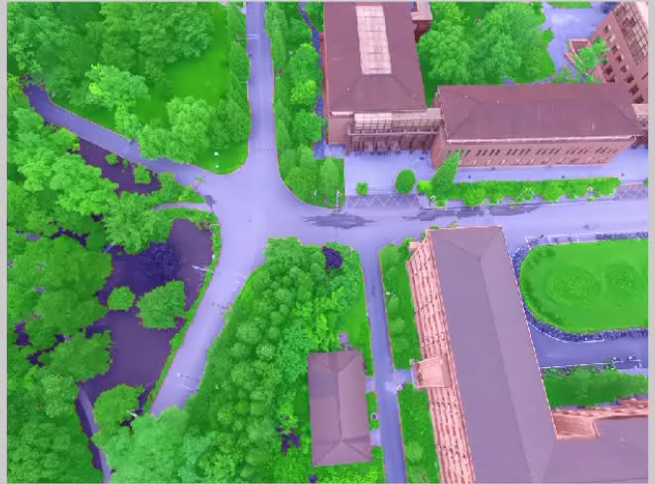
Dataset glimpse

Slide 9
Training
Hyper Parameters
Backbone network | ResNet-101 Imagenet pretrained model
Optimizer | Adam
Crop size | 513*513
Init Learning rate | 2.5e-4
Momentum | 0.99
batch size | 6
Weight decay | 2e-4
Max epoch | 10
Result
MIoU | 88.7
Mean accuracy | 94.1

Slide 10
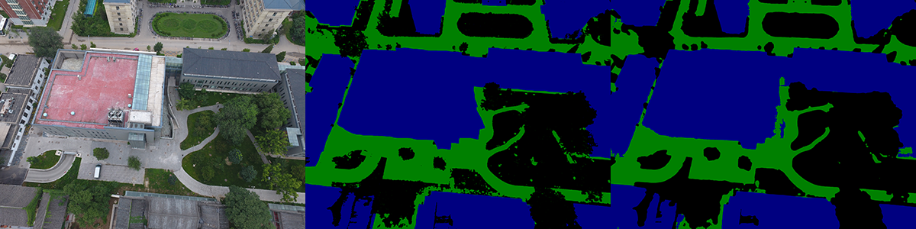
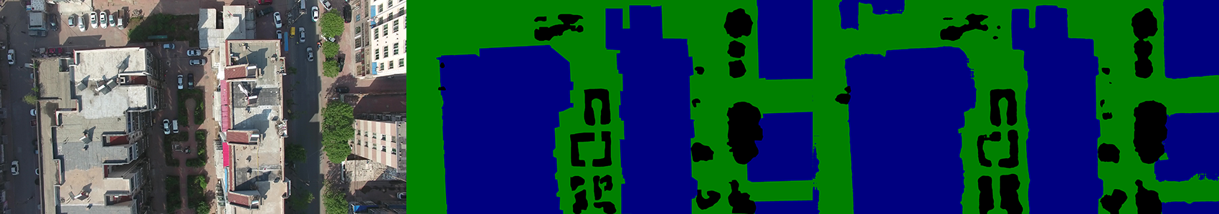
Result-validation
campus
huludao

Slide 11
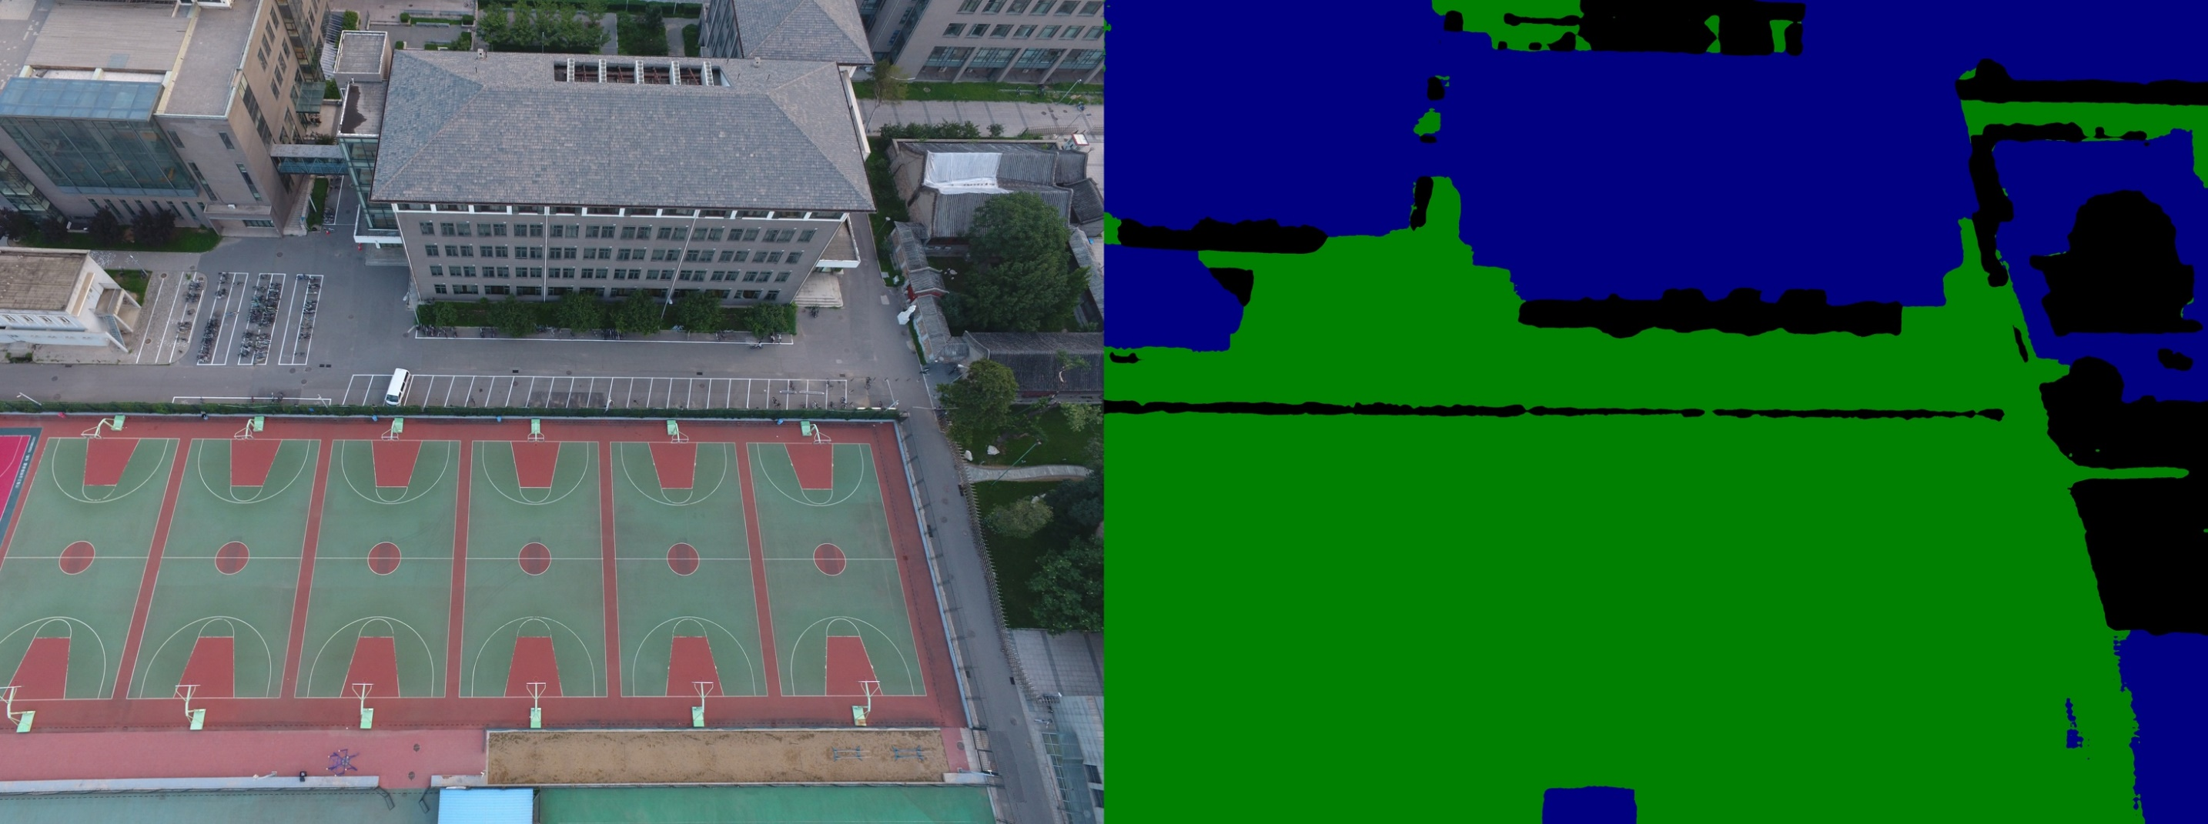
Result-test
campus

Slide 12
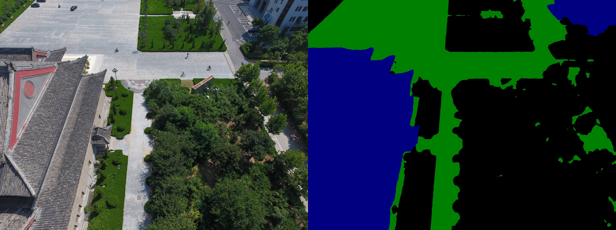
Result-test
Heda-dalitang

Slide 13
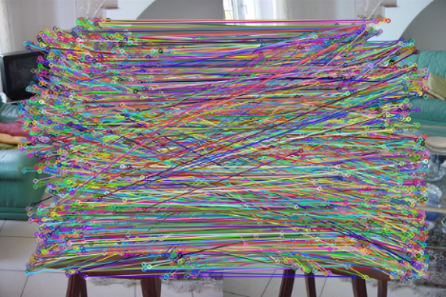
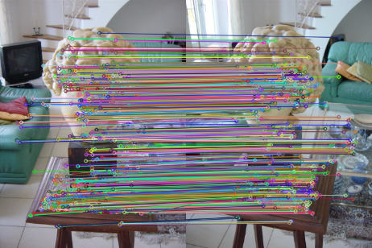
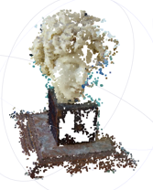
Pipeline for SfM
Pictures
Feature Matching
Geometric Verifying
Initial Pair Selection
Bundle Adjustment
Triangulation
Camera Registeration
sparse model

Slide 14
Two Main Bottlenecks
60%
30%
Feature Matching
Bundle Adjustment

Slide 15
Semantic Feature Extracts
- SIFT keypoint detector
- Extract semantic label by semantic segmentation result
- Group features by semantic label, then perform feature matching

Slide 16
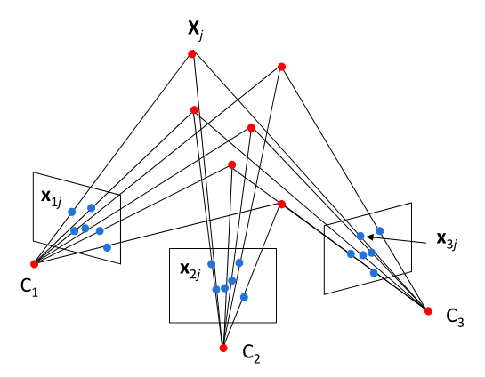
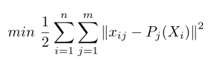
Unonstrained Bundle Adjustment
- Unconstrained Bundle Adjustment
- Solved by Levenburg-Marquart approach

Slide 17
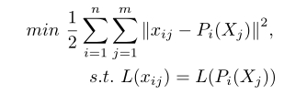
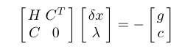
Constrained Bundle Adjustment
- Constrained Bundle Adjustment
- Solved by Sequential Quadratic Programming

Slide 18
Reconstruction Results
Original SfM
Semantic SfM
Dataset
Views
Poses
Residuals
RMSE
Views
Poses
Residuals
RMSE
PKU-m1
52
52
388096
0.421443
52
52
274027
0.376776
PKU-e3_3
60
60
272143
0.524914
60
60
178258
0.490911
Heda-Dalitang
97
97
789944
0.318991
97
97
689435
0.304753

Slide 19
Result Display
使用nodejs搭建一个本地网站进行结果展示
Nodejs 较为轻量级，可以在localhost:3000运行
可以通过网页提交模型文件
使用网页展示结果，更加直观

Slide 20
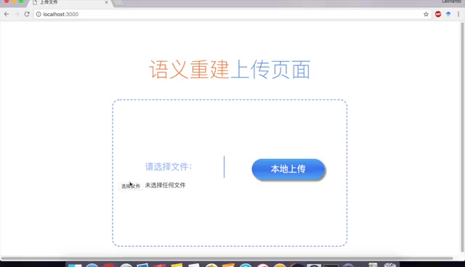
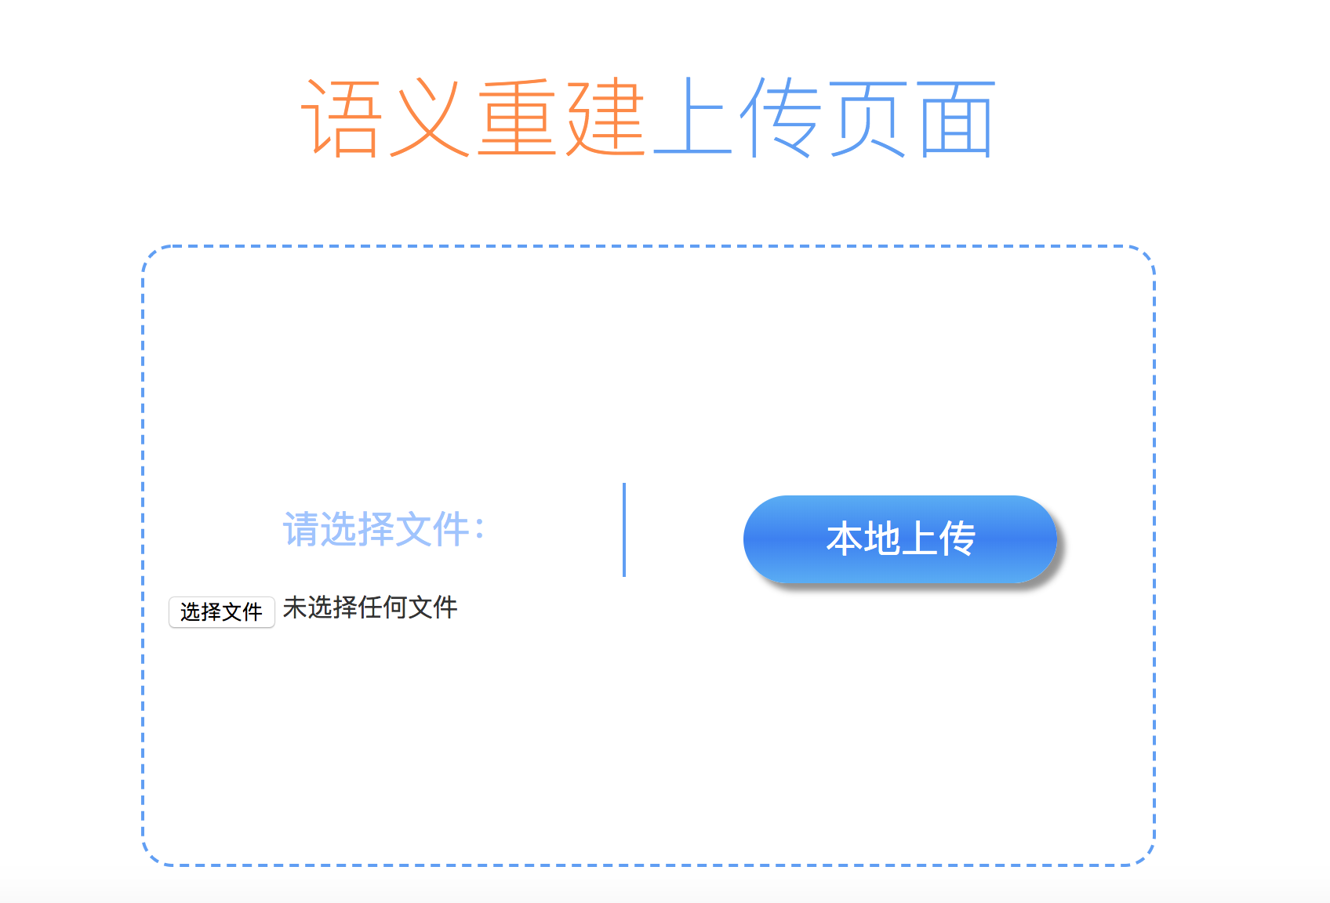
Model Upload

Slide 21
Model Render
使用WebGL来处理模型的导入
使用three.js来导入模型，读取模型的点位置
使用PointsMaterial来渲染模型的颜色
使用canvas在web页面展示模型
使用controller来添加模型控制，可以对模型进行旋转操作

Slide 22
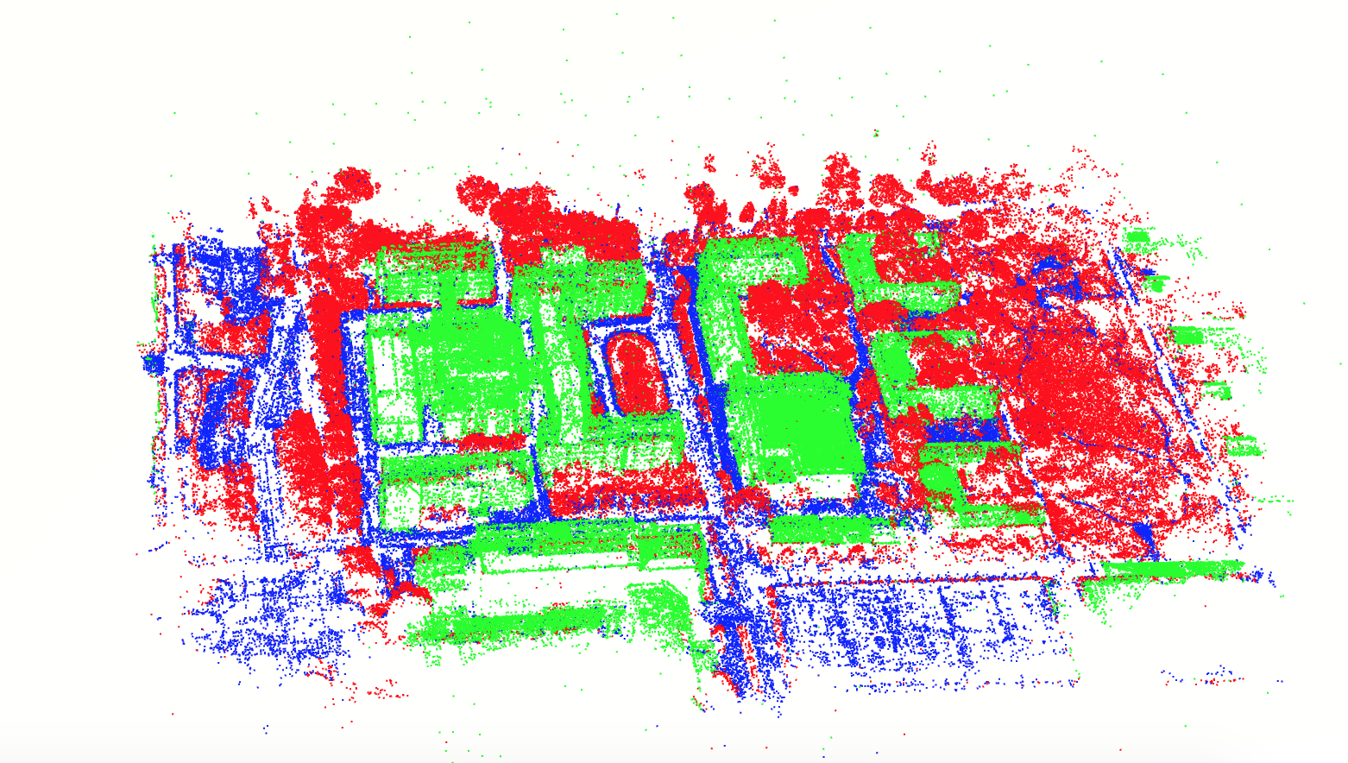
Model Display

Slide 23
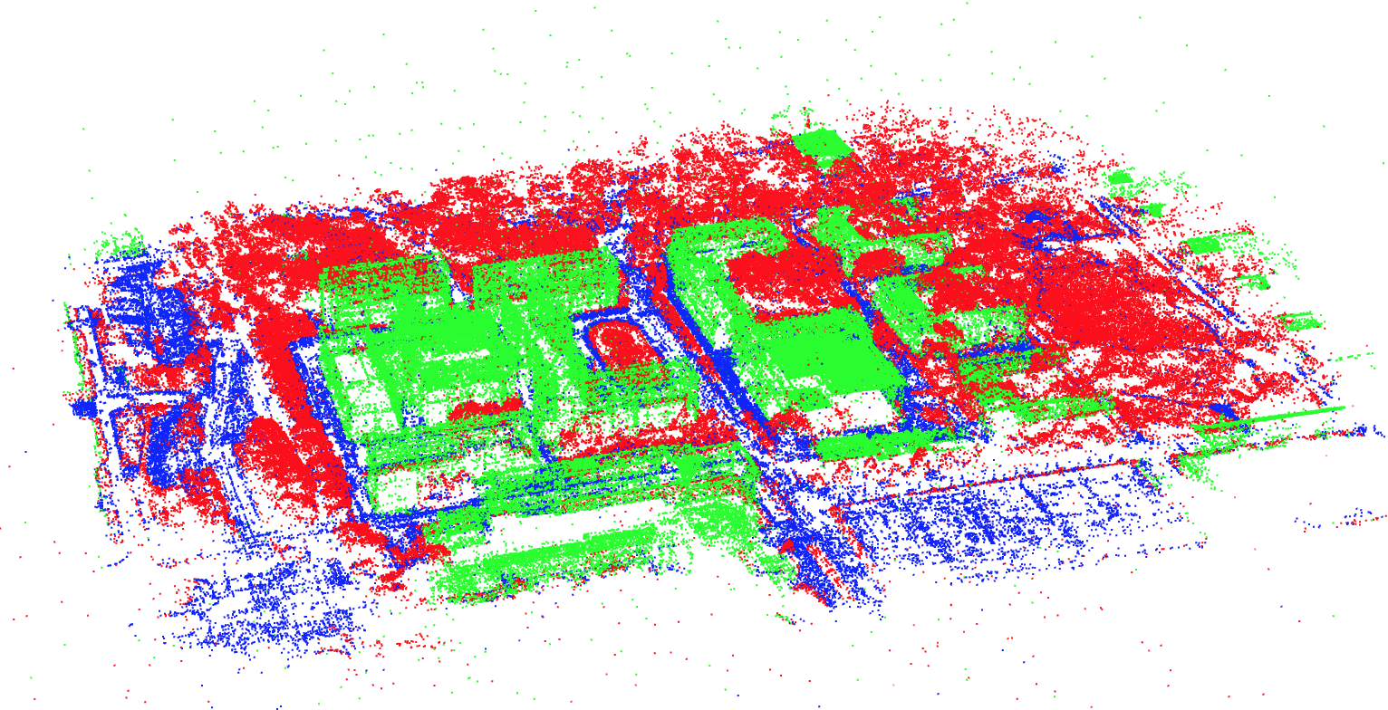
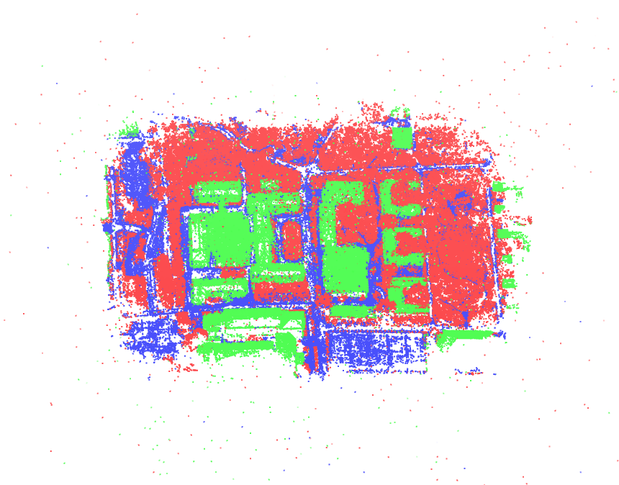
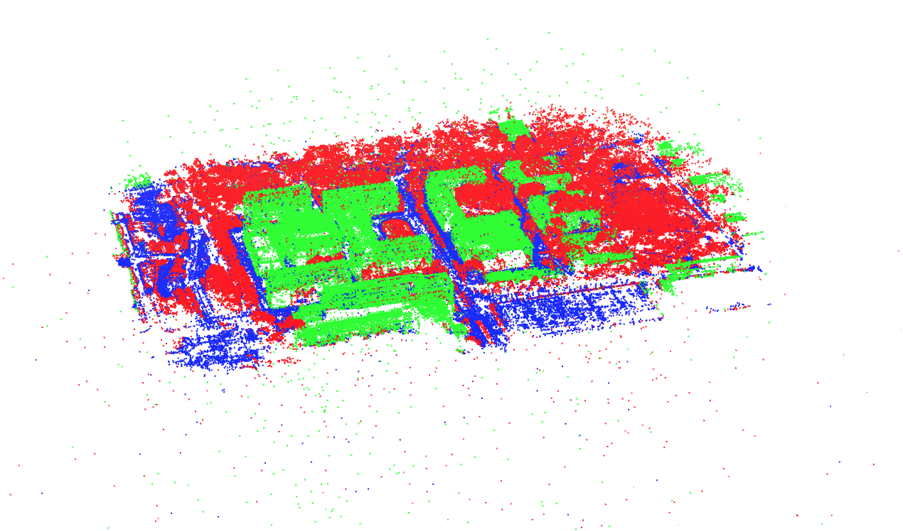
Model Display

Slide 24
Future Work
- Learning semantic features
- Dense reconstruction for automatic semantic segmentation

Slide 25
References
[1] Noah Snavely, Steven M. Seitz, Richard Szeliski. Photo Tourism: Exploring image collections in 3D. ACM Transactions on Graphics (Proceedings of SIGGRAPH 2006), 2006.
[2] Snavely K N. Scene reconstruction and visualization from internet photo collections[M]. University of Washington, 2008.
[3] Schönberger J L, Frahm J M. Structure-from-Motion Revisited[C]// Computer Vision and Pattern Recognition. IEEE, 2016.
[4] Wu C. Towards Linear-Time Incremental Structure from Motion[C]// International Conference on 3dtv-Conference. IEEE, 2013:127-134.
[5] Moulon P, Monasse P, Marlet R. Adaptive structure from motion with a contrario, model estimation[C]// Asian Conference on Computer Vision. Springer Berlin Heidelberg, 2012:257-270.
[6] Schönberger J L, Frahm J M. Structure-from-Motion Revisited[C]// Computer Vision and Pattern Recognition. IEEE, 2016.
[7] Sweeney C, Hollerer, Tobias, Turk M. Theia: A Fast and Scalable Structure-from-Motion Library[J]. 2015:693-696.
[8] Fischler M A, Bolles R C. Random sample consensus: a paradigm for model fitting with applications to image analysis and automated cartography[J]. Readings in Computer Vision, 1987, 24(6):726-740.
[9] Triggs B, Mclauchlan P F, Hartley R I, et al. Bundle Adjustment - A Modern Synthesis[C]// International Workshop on Vision Algorithms: Theory and Practice. Springer-Verlag, 1999:298-372.
[10] Wilson K, Snavely N. Robust Global Translations with 1DSfM[C]// European Conference on Computer Vision. Springer, Cham, 2014:61-75.
[11] Crandall D, Owens A, Snavely N, et al. Discrete-continuous optimization for large-scale structure from motion[C]// Computer Vision and Pattern Recognition. IEEE, 2011:3001-3008.
[12] Farenzena M, Fusiello A, Gherardi R. Structure-and-motion pipeline on a hierarchical cluster tree[C]// IEEE, International Conference on Computer Vision Workshops. IEEE, 2009:1489-1496.
[13] Gherardi R, Farenzena M, Fusiello A. Improving the efficiency of hierarchical structure-and-motion[C]// Computer Vision and Pattern Recognition. IEEE, 2010:1594-1600.
[14] Toldo R, Gherardi R, Farenzena M, et al. Hierarchical structure-and-motion recovery from uncalibrated images[J]. Computer Vision \& Image Understanding, 2015, 140(C):127-143.
[15] Chen Y, Chan A B, Lin Z, et al. Efficient tree-structured SfM by RANSAC generalized Procrustes analysis[J]. Computer Vision \& Image Understanding, 2017, 157(C):179-189.
Notes:
模板来自于 http://www.ypppt.com

Slide 26
THANKS FOR LISTENING

